Slide 1

JIM LAMB
Sr. UX Designer, Microsoft

Slide 2

I’m a user experience designer, product strategist, and information architect.
I help teams create products and experiences that solve real user problems.
I use flow mapping, storyboarding, and prototyping to inform and guide the product development process.

Slide 3
My areas of focus
Product Strategy
Align design with an iterative product release process allows for customer feedback and continuous improvement.
Information Architecture
Understand the users’ mental model of the problem domain. Use labeling, navigation, and search systems to organize and present data in the most useful way.
Experience Design
Understand the user’s experience from end-to-end including aspects beyond the screen. Use wireframes, storyboards, and prototypes to clearly communicate designs.

Slide 4

About Azure DevOps
Azure DevOps is a Software as a service (SaaS) platform from Microsoft that provides an end-to-end DevOps toolchain for developing and deploying software.

Slide 5
1,014,426
Long-term engaged Azure DevOps users as of 3/17/2020

Slide 6
Some useful concepts
Pipeline
Made up of one or more stages, a pipeline can build code or deploy to one or more environments.
Stage
A stage is a way of organizing jobs in a pipeline and each stage can have one or more jobs.
Job
Each job runs on one agent.
Agent
An agent is a physical or virtual machine that runs a job containing one or more steps.
Step
A step can be a task or script and is the smallest building block of a pipeline.
Trigger
Tells a pipeline when to run.

Slide 7
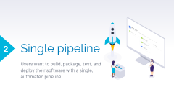
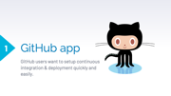
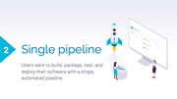
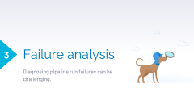
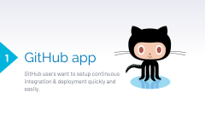
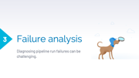
Recent projects
I’m the primary designer for Azure Pipelines. I worked with a team of eleven designers and one researcher to support Azure DevOps’ 300+ engineers and program managers.

Slide 8

GitHub app
1
GitHub users want to setup continuous integration & deployment quickly and easily.

Slide 9
Goals
Help GitHub users get started with Azure Pipelines
Use GitHub’s new App model
Support configuration-as-code
I was the lead designer for this project supporting a team of about 12 engineers with 1 program manager over about 3 months. I worked closely with the design system team as we defined new patterns and components to support this experience.

Slide 10
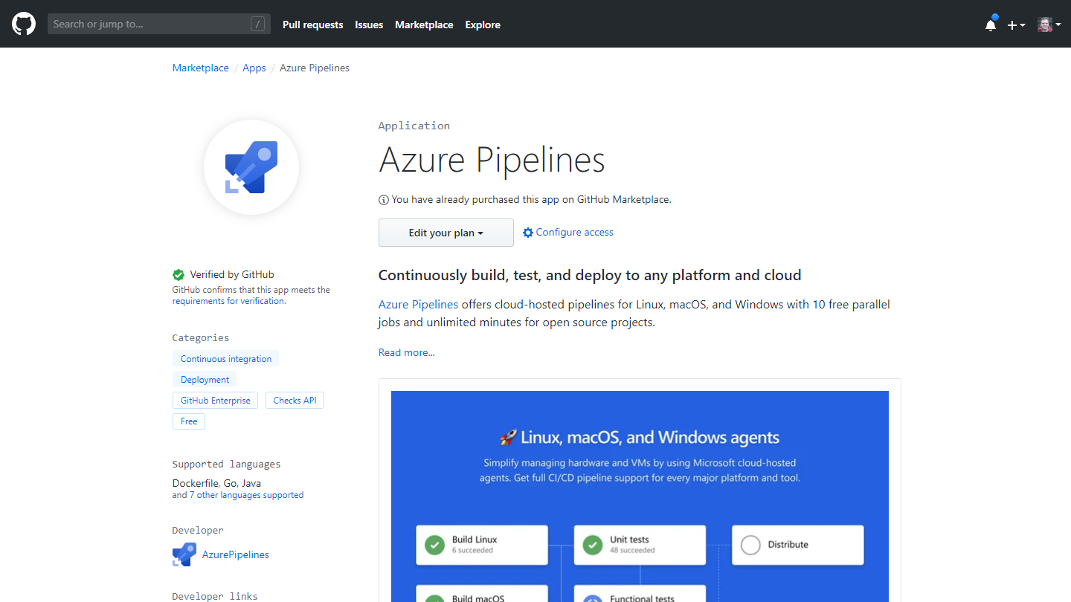
GitHub marketplace
Pipelines App

Slide 11
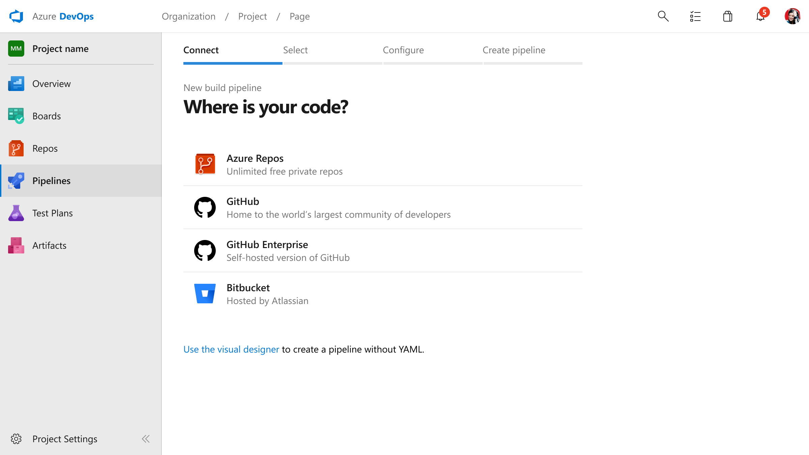
Connect
Acquisition flow

Slide 12
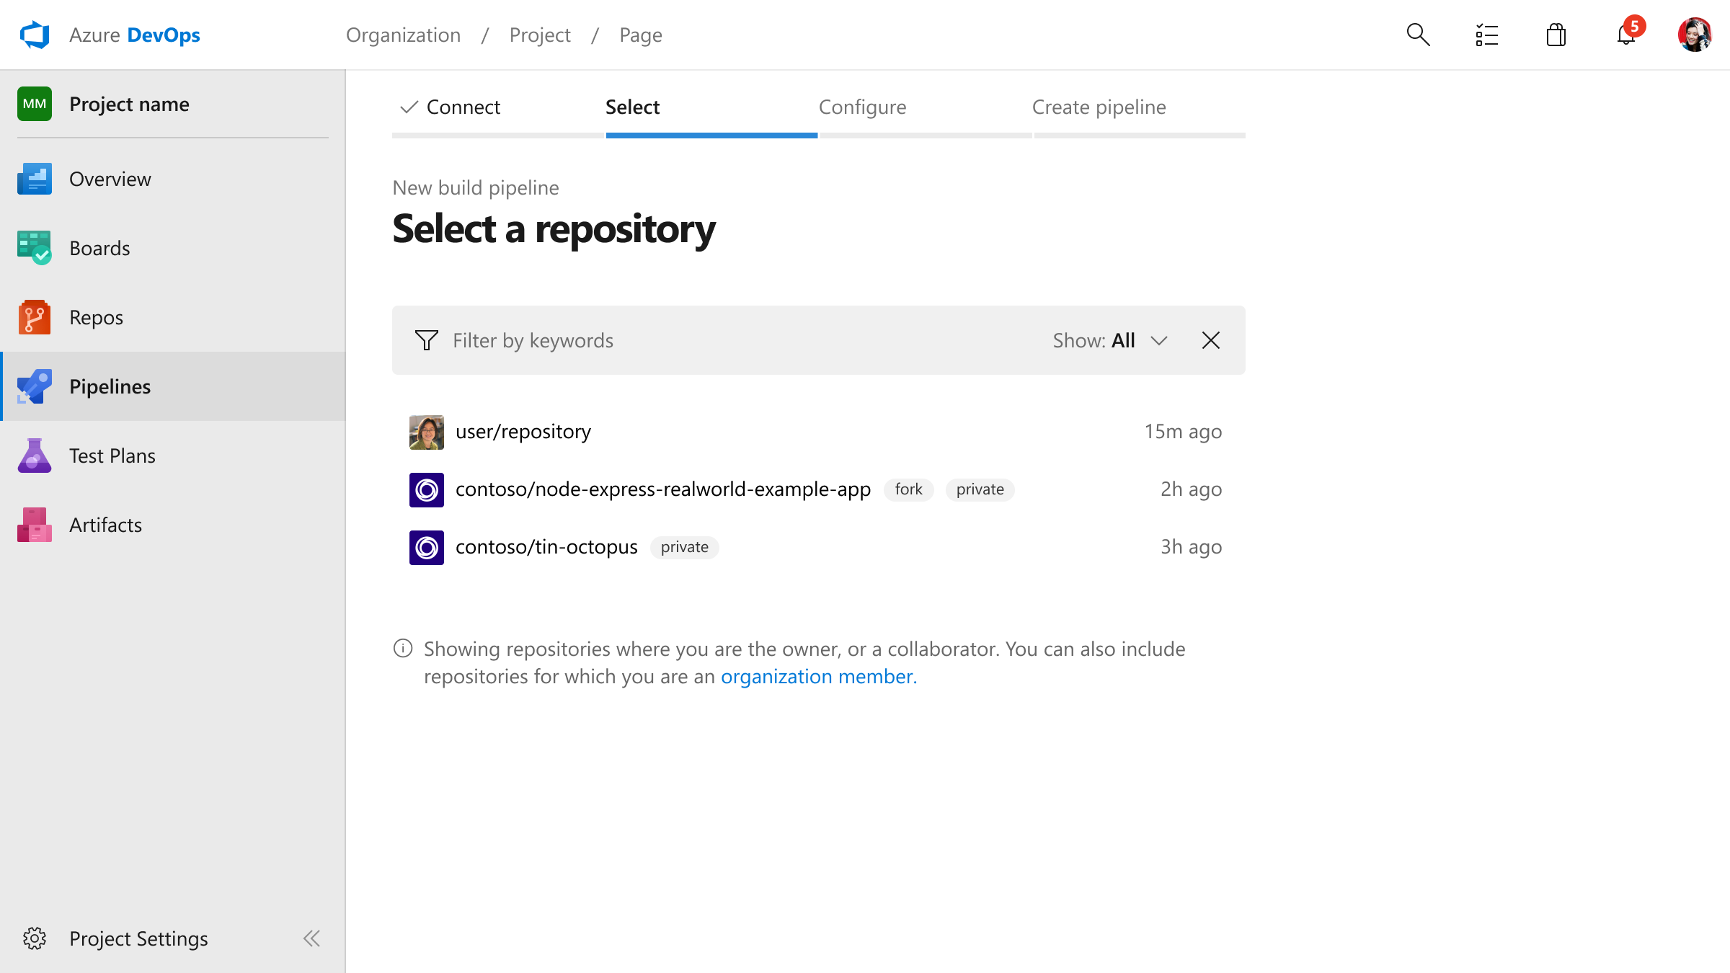
Select repo
Acquisition flow

Slide 13
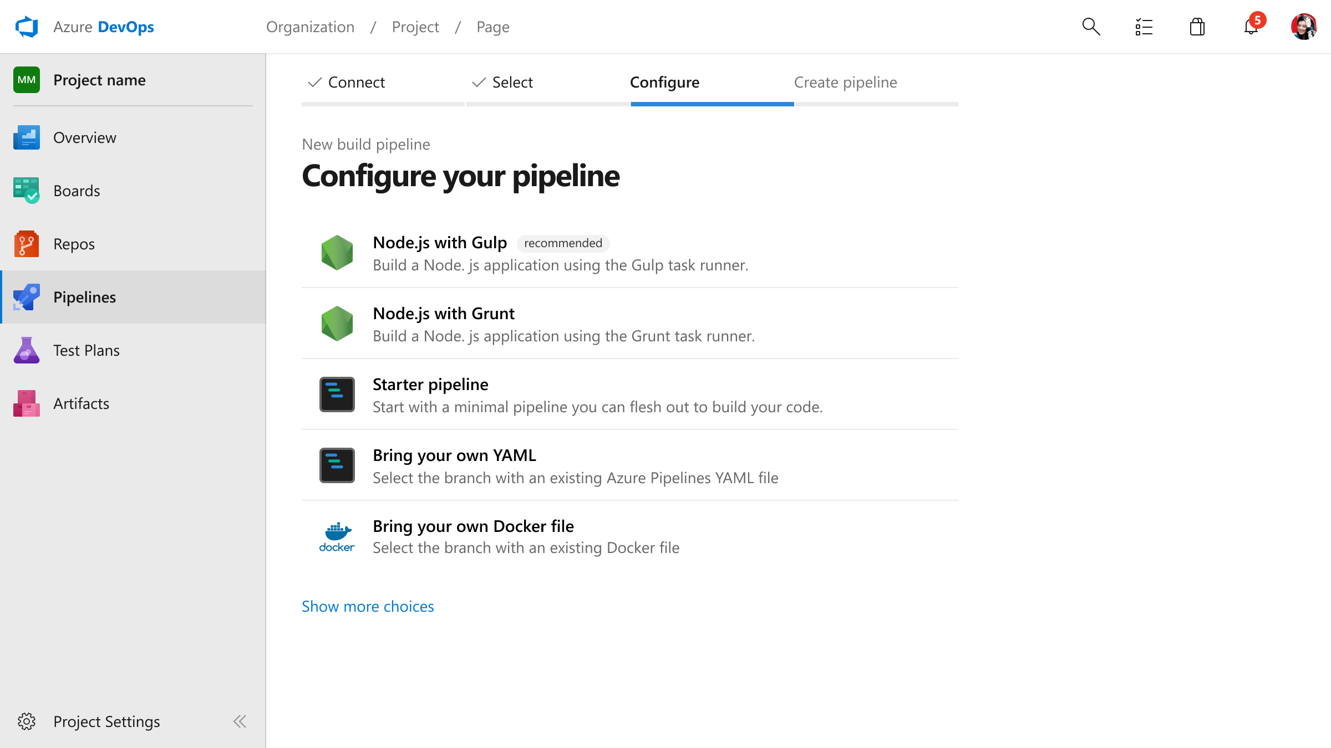
Configure pipeline
Acquisition flow

Slide 14
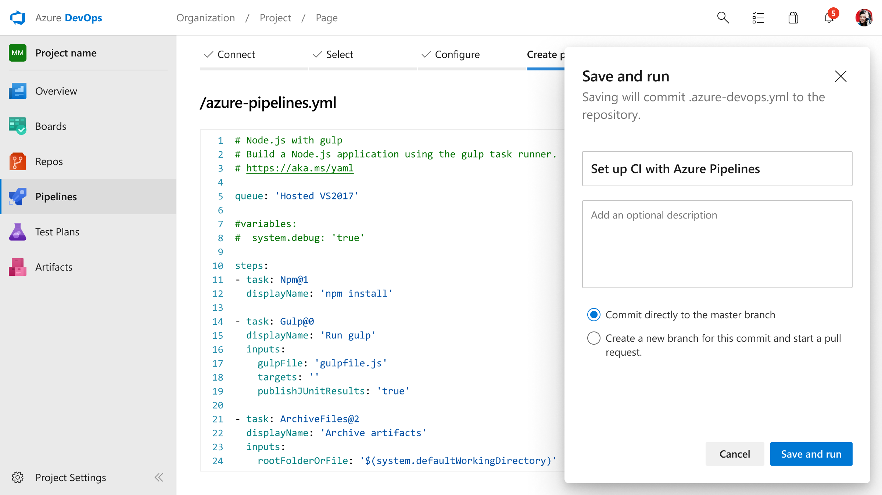
Save and run
Acquisition flow

Slide 15
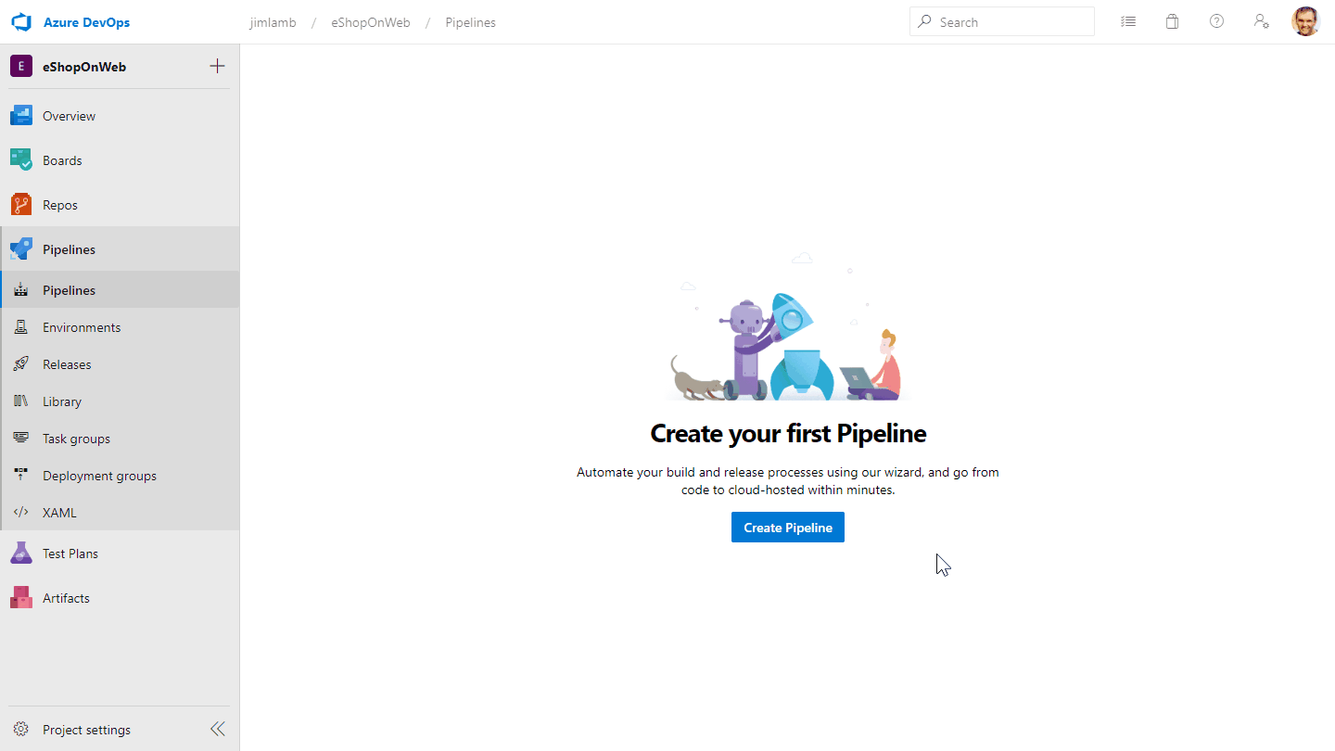
Recorded walkthrough

Slide 16
Challenges
Cross-service authentication
Balancing approachability for new users with flexibility for experienced ones
Getting too far out ahead of the design system

Slide 17
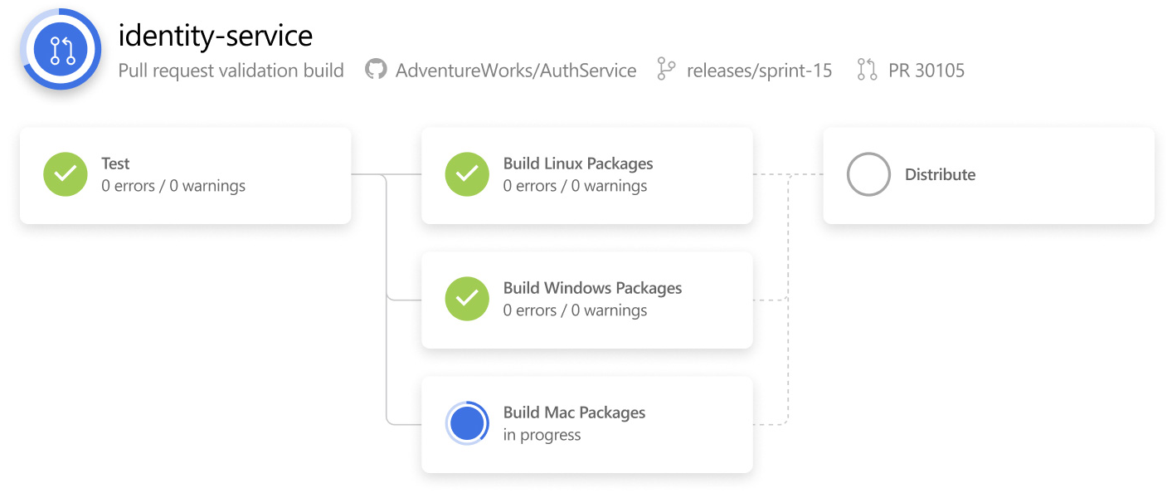
Single pipeline
2
Users want to build, package, test, and deploy their software with a single, automated pipeline.

Slide 18
Goals
Integrate the build and release areas of Azure DevOps into a single pipeline experience
Support configuration as code
Preserve support for complex scenarios while simplifying the experience for most users
I worked with two other designers (who were new to the team) and two researchers over about 9 months.

Slide 19
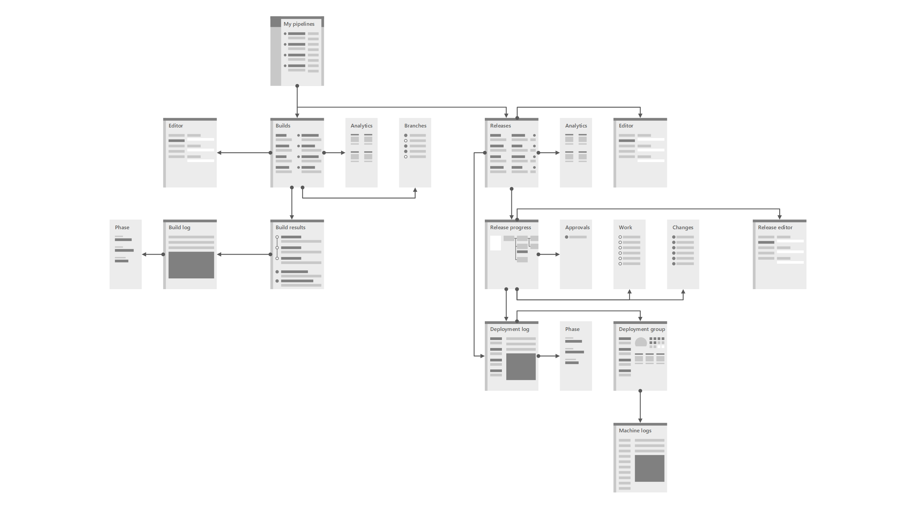
Overview
Build and Release screens

Slide 20
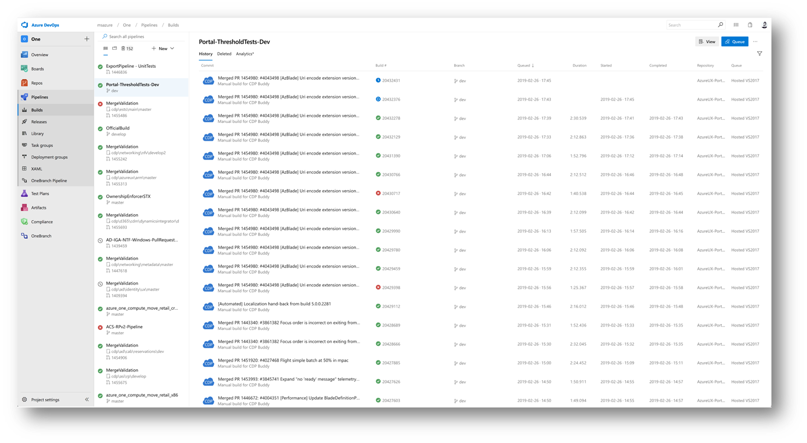
Previous Build UI

Slide 21
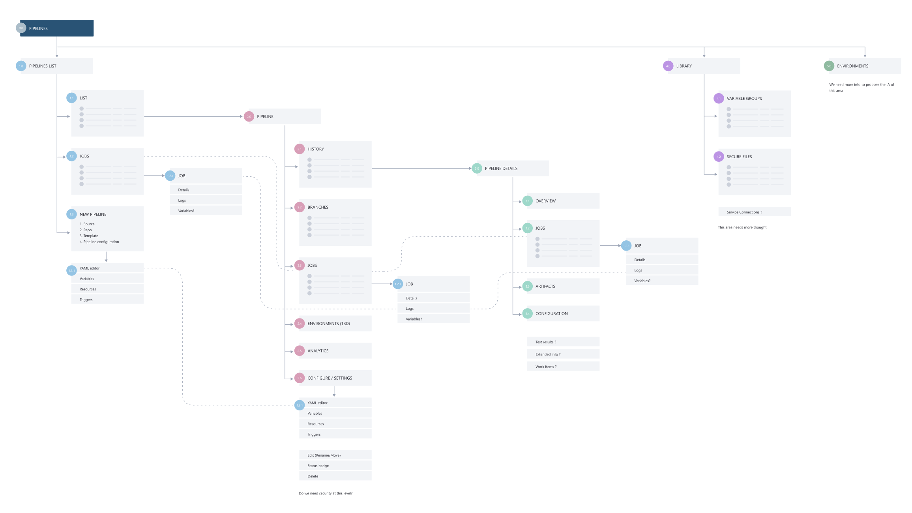
Information architecture

Slide 22
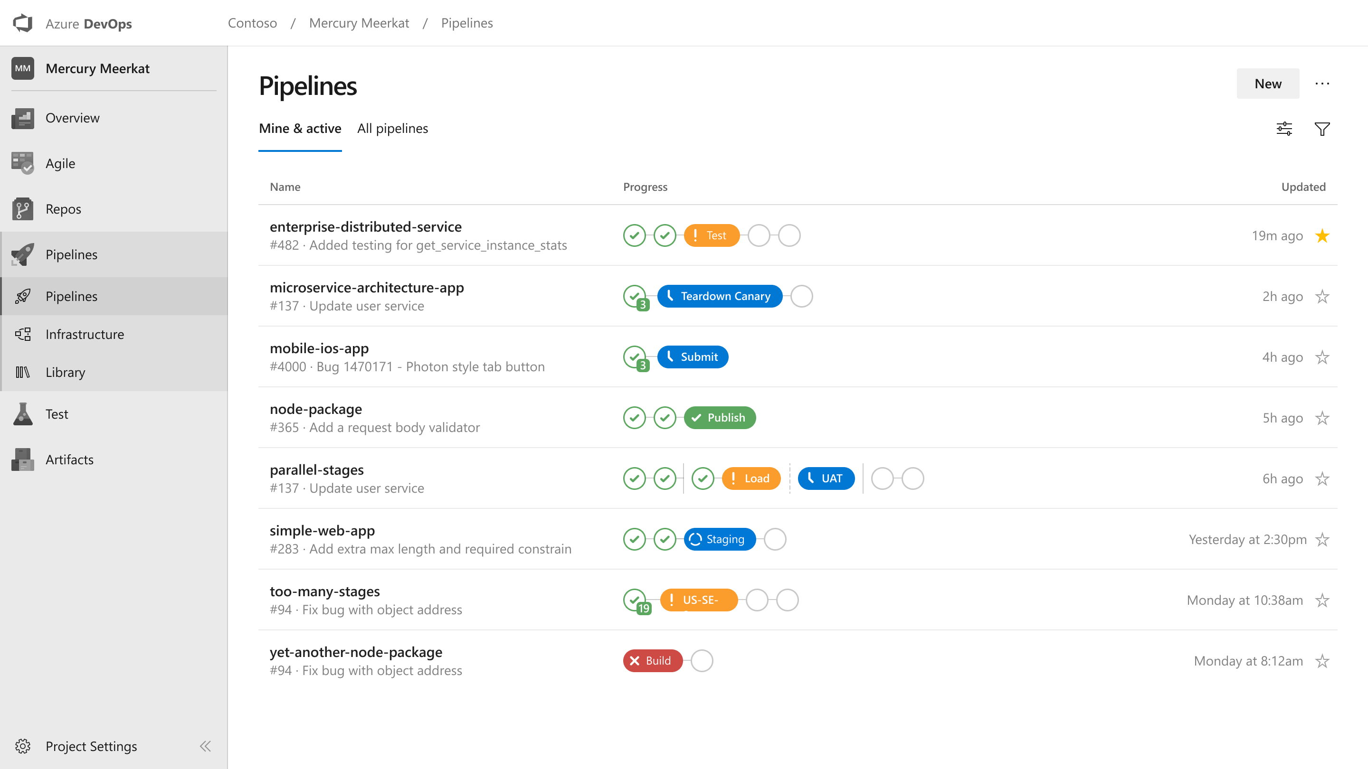
Single pipeline
Early exploration

Slide 23
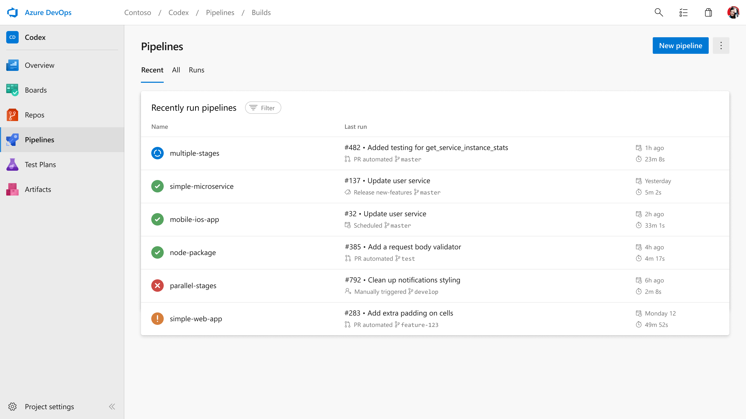
Single pipeline
Mock for usability study

Slide 24
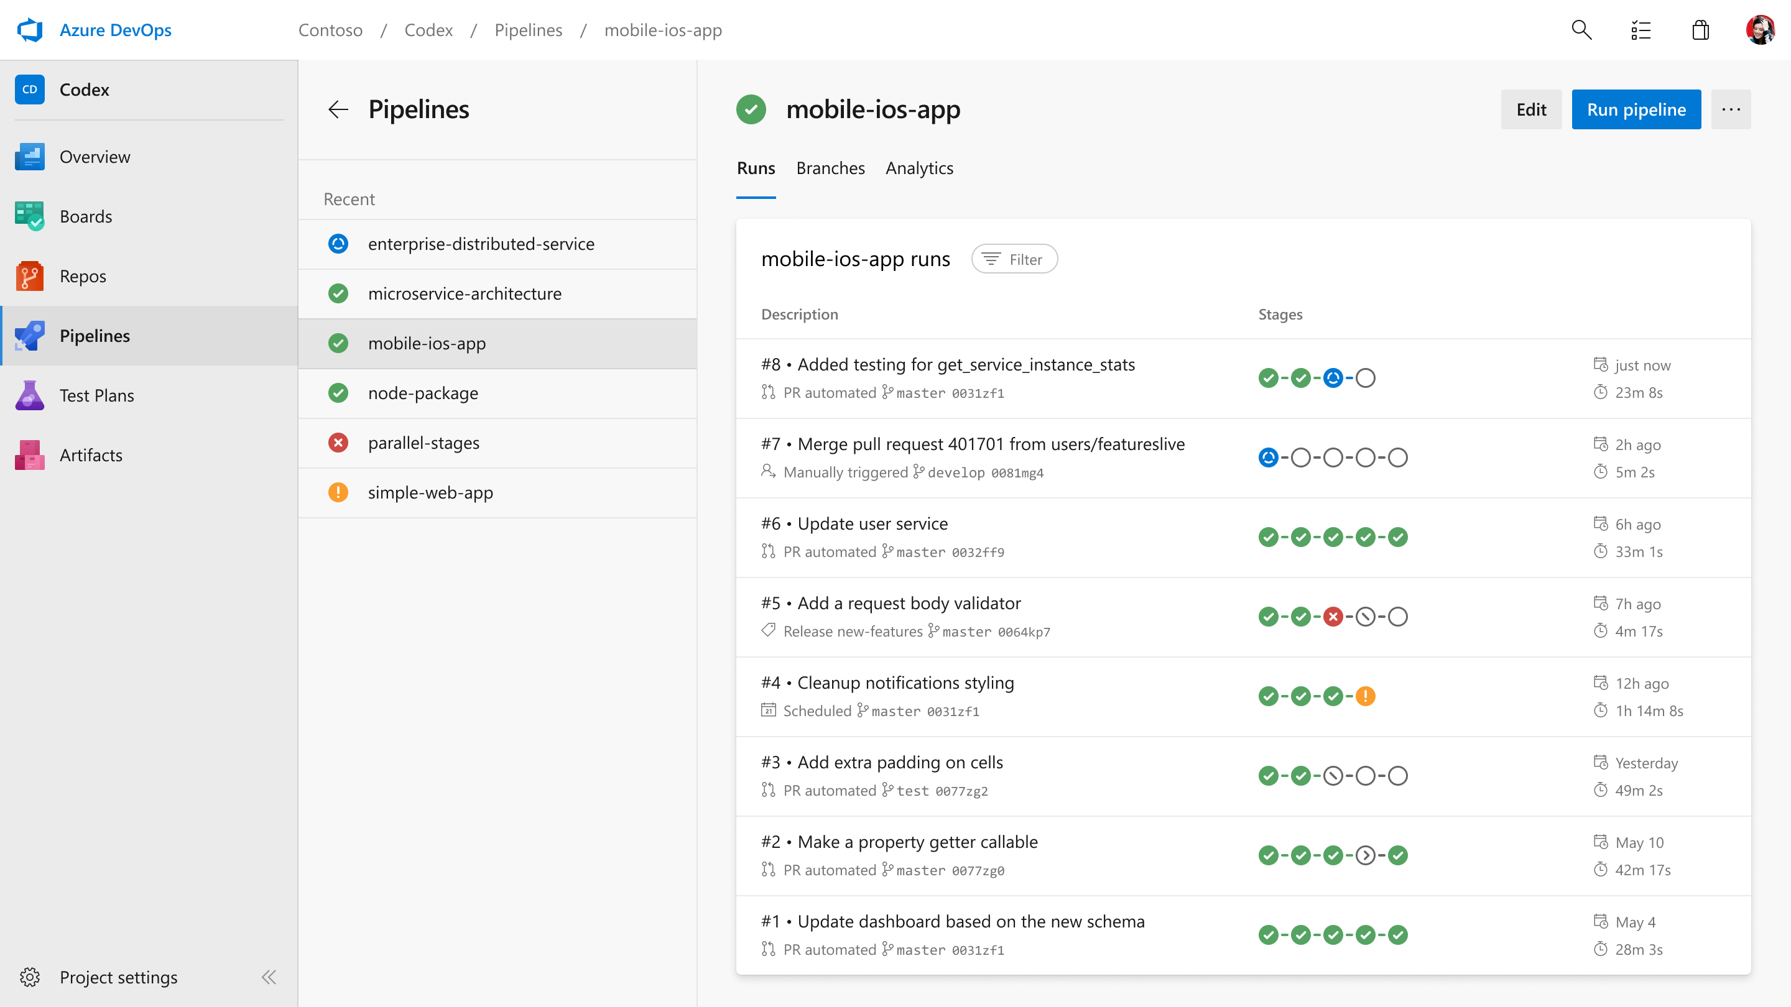
Single pipeline
Pipeline runs

Slide 25
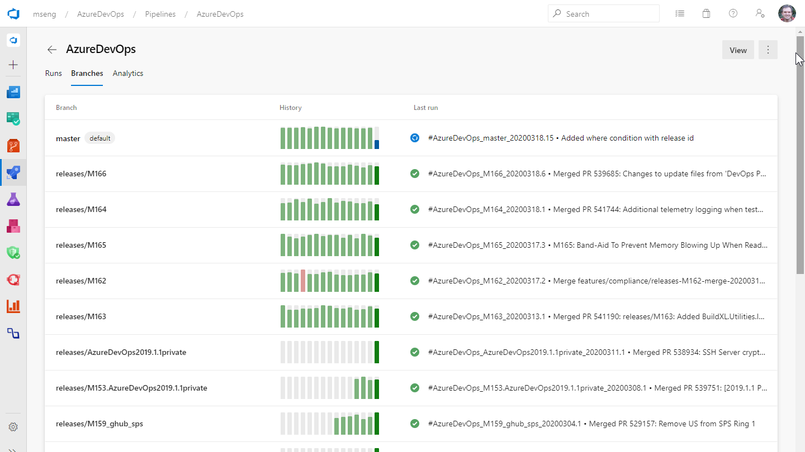
Single pipeline
Branches

Slide 26
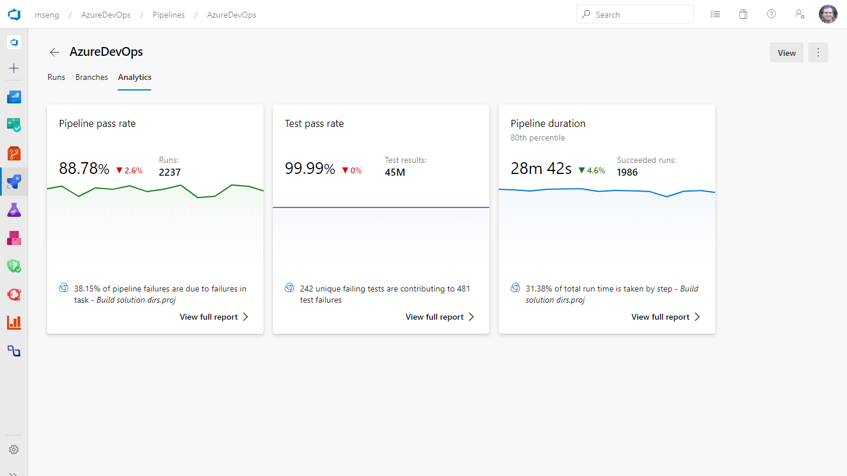
Single pipeline
Analytics

Slide 27
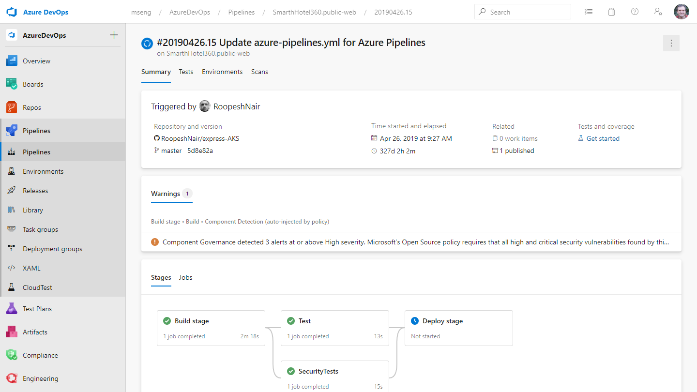
Single pipeline
Pipeline run details

Slide 28
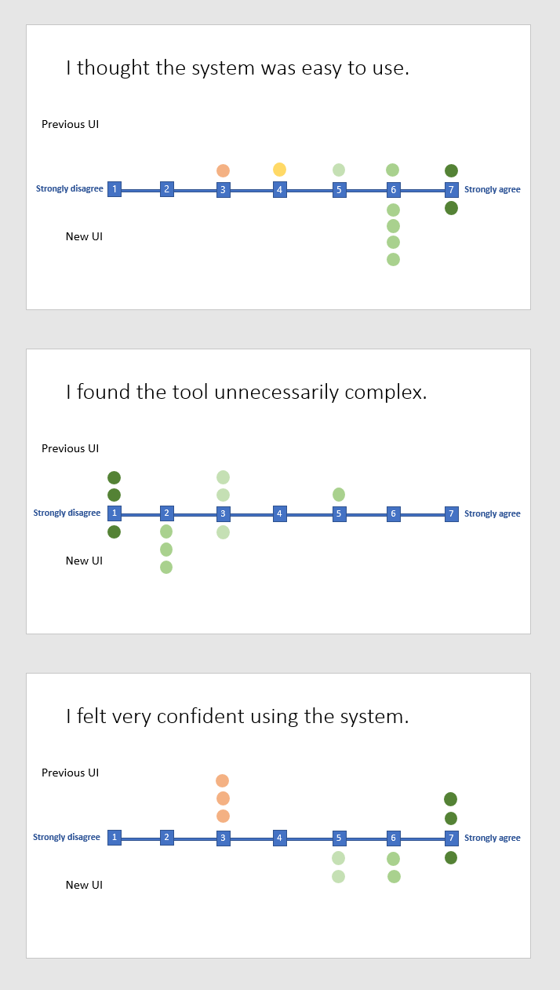
User research
Directed interviews, roundtables, and card sorts with “modern developers”
User feedback
Usability tests based on static mock-ups and click-through prototypes

Slide 29
I liked the ease of use and intuitive nature of the design. I liked how the different groupings were done. It was easy to see.

Slide 30
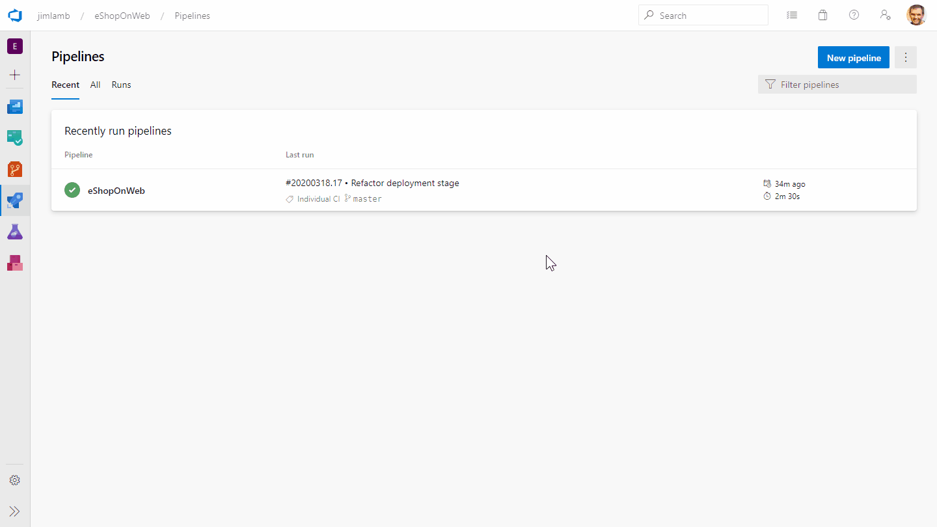
Recorded walkthrough

Slide 31
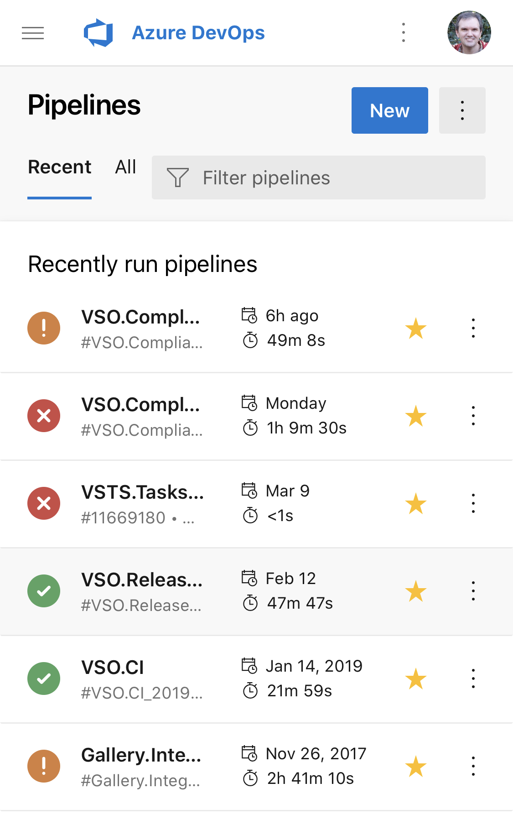
Place your screenshot here
Mobile views
We also designed mobile versions of commonly used views

Slide 32
Challenges
Simpler isn’t always better
Design for scale and performance
Don’t over index for features users haven’t adopted yet

Slide 33

Failure analysis
3
Diagnosing pipeline run failures can be challenging.

Slide 34
Goals
Provide decision support for failed runs
Improve customer satisfaction
Reduce support costs
I proposed this experience when my team was looking for ways to reduce support costs without negatively affecting customers.

Slide 35
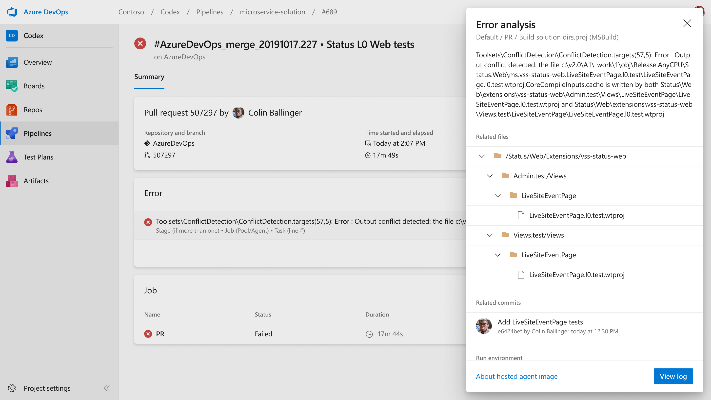
Error analysis
Overview

Slide 36
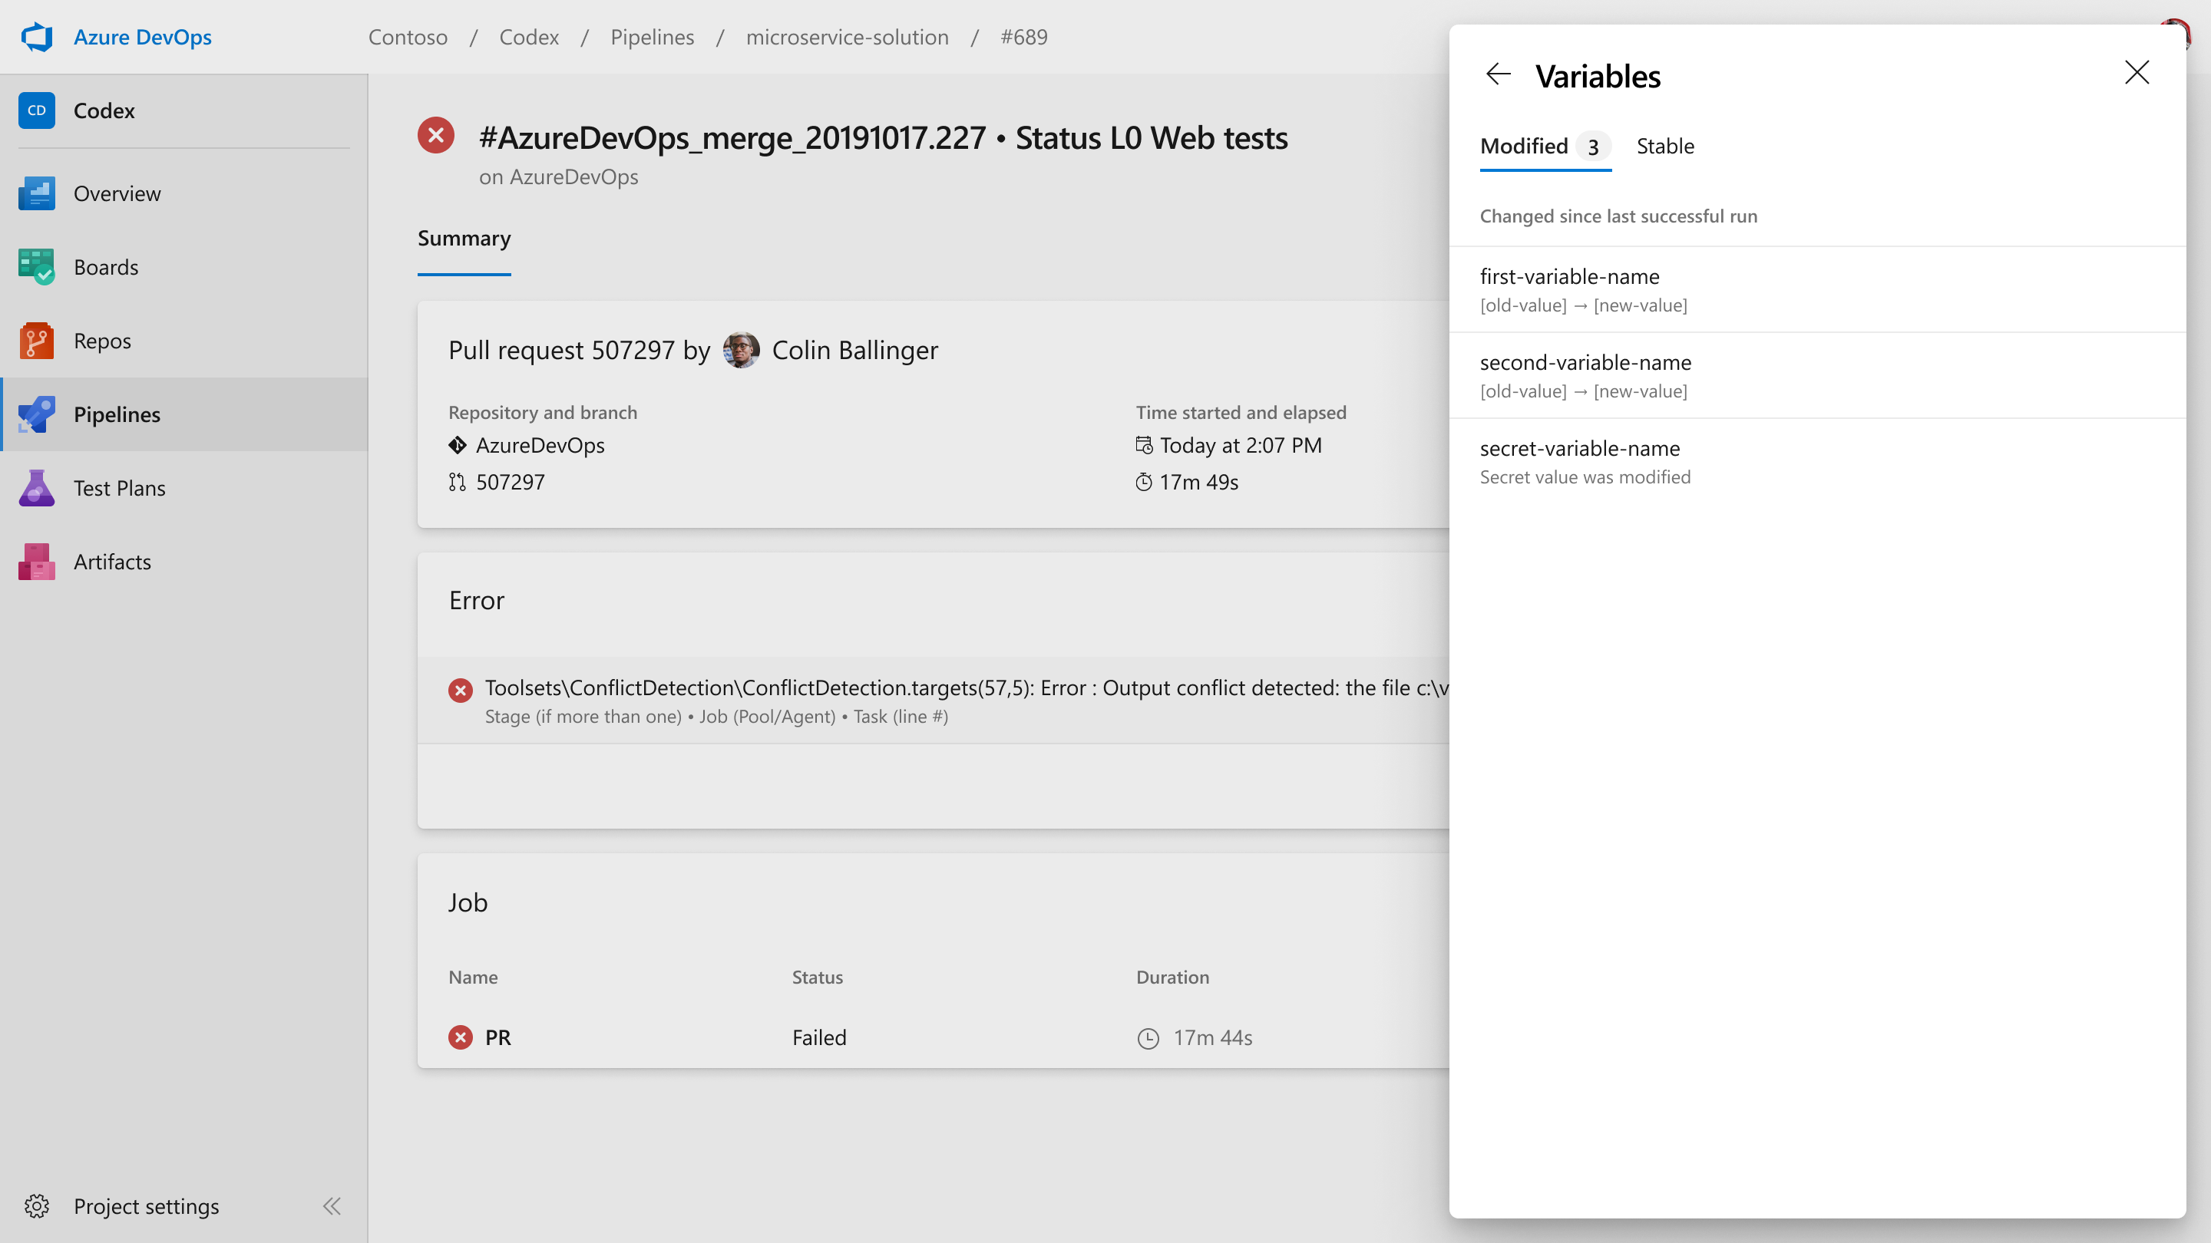
Error analysis
Variables

Slide 37
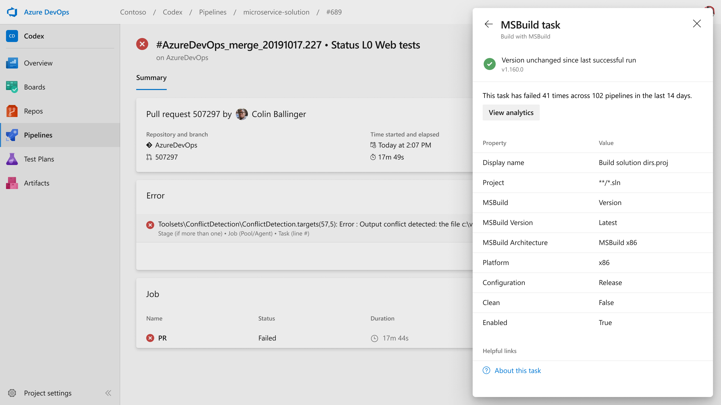
Error analysis
Task settings

Slide 38
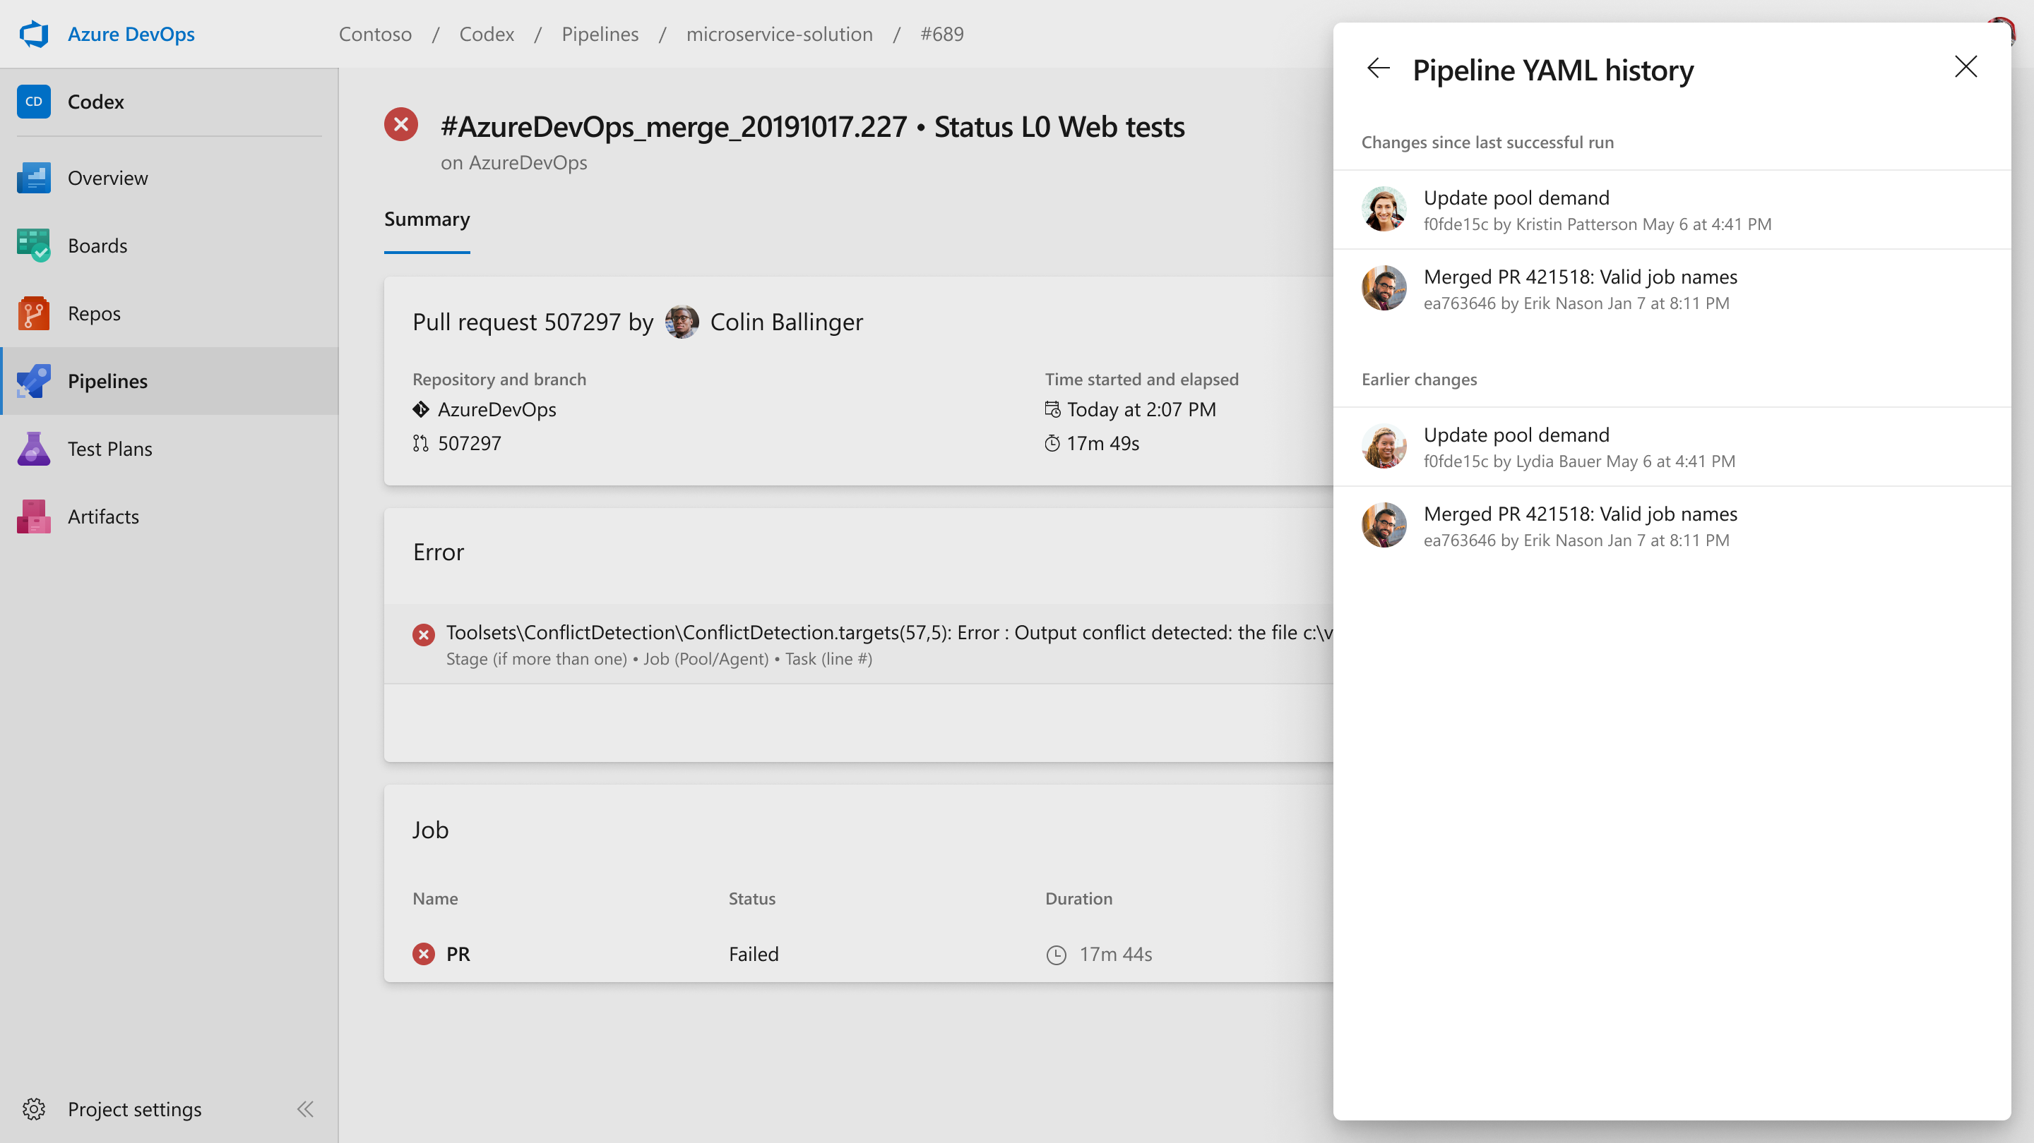
Error analysis
YAML history

Slide 39
Challenges
Lobbying product management
Staged delivery
Feature prioritization
Product management recently agreed to the first stage of this work. I’m working with the engineering team to deliver it now.

Slide 40
Pipeline logs
4
Users need to follow runs as they progress and easily investigate failures.

Slide 41
Pipeline logs
Improve performance, especially at scale
Simplify navigation to errors and warnings
Make it easier to follow runs in progress
I was the only designer iterating on work by two designers who had left the team. Over about 3 months, I worked closely with engineering to solve several interaction issues with the previous design.

Slide 42
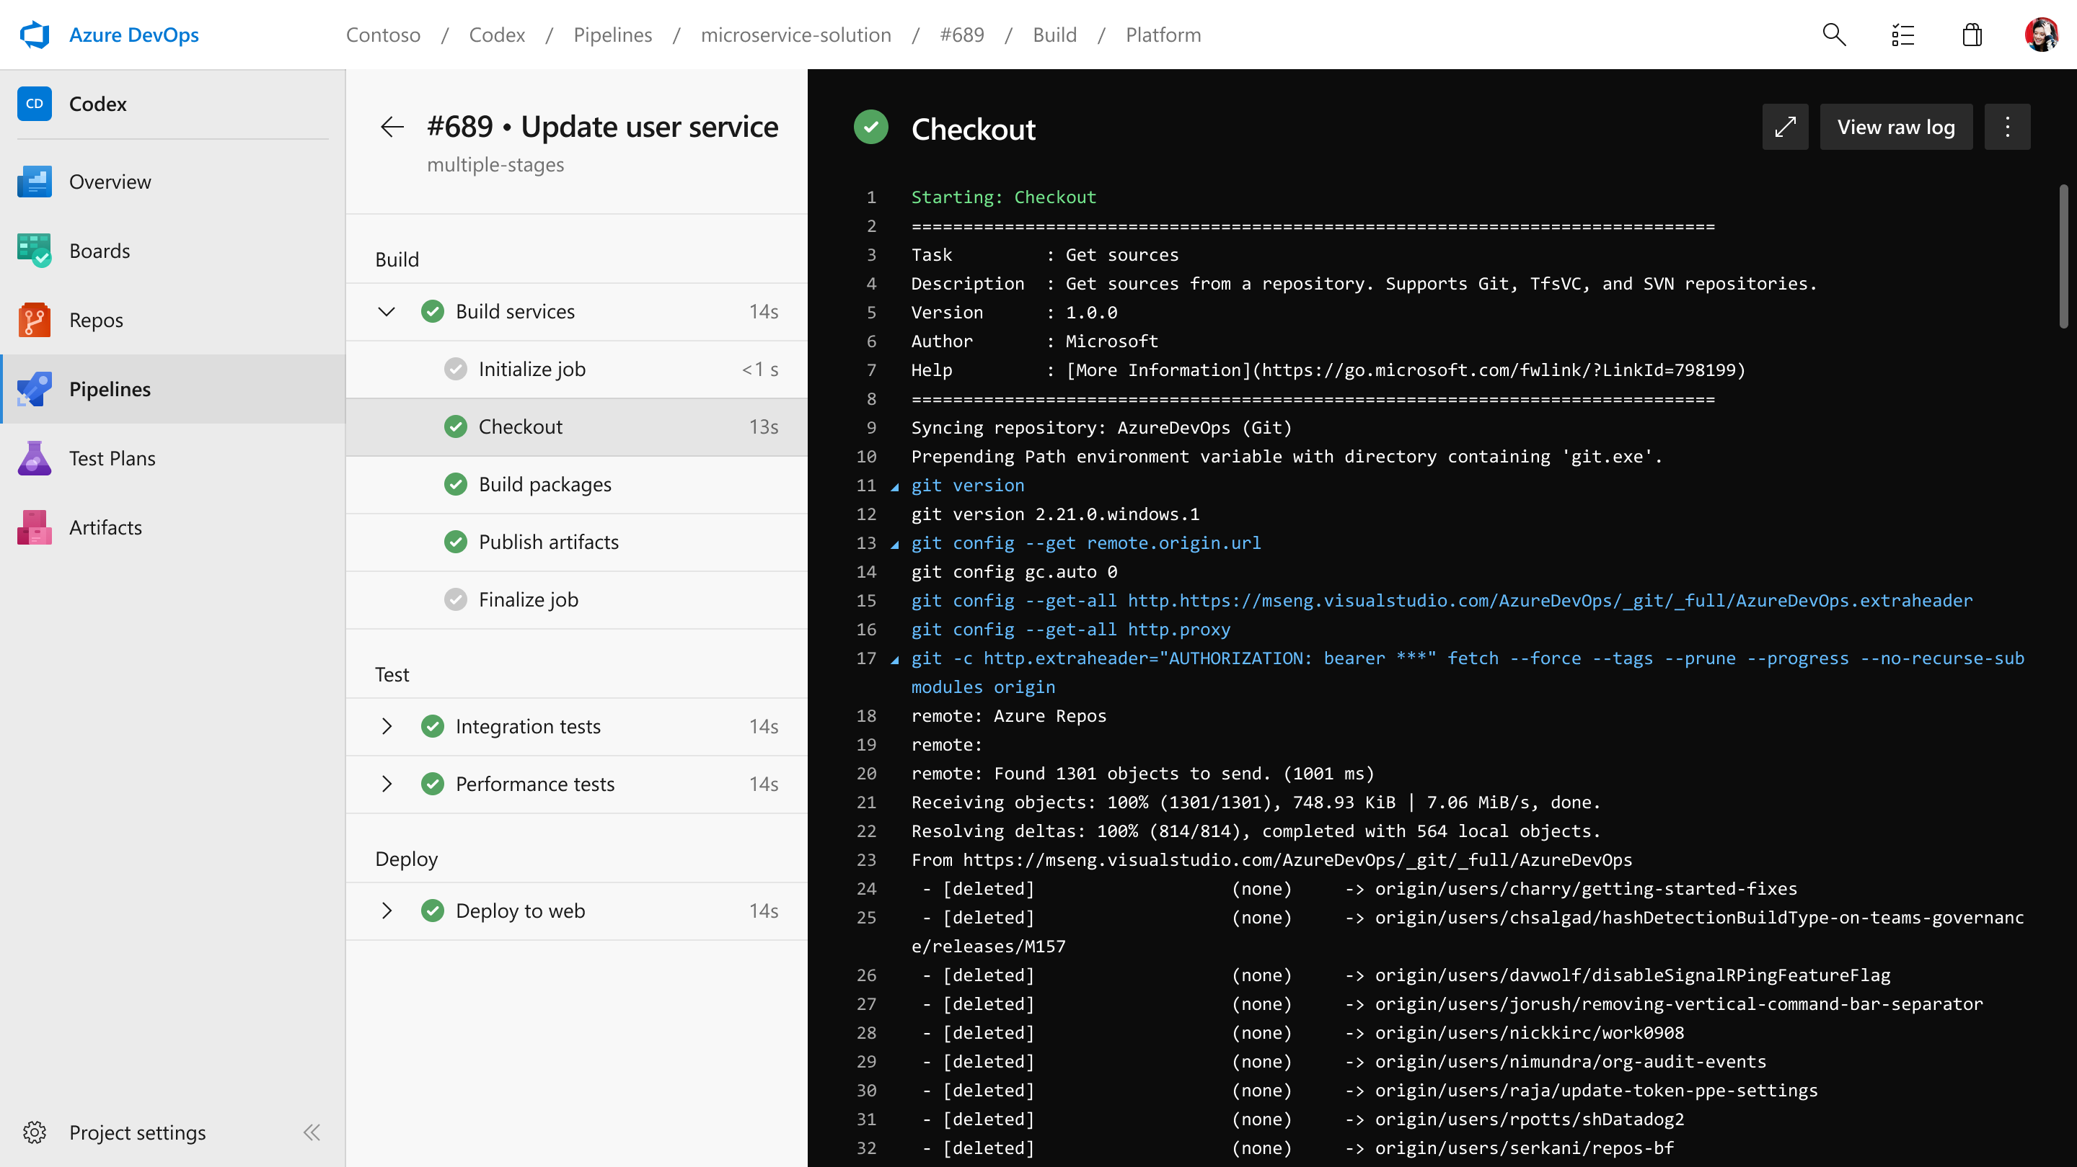
Pipeline logs
Multiple stages

Slide 43
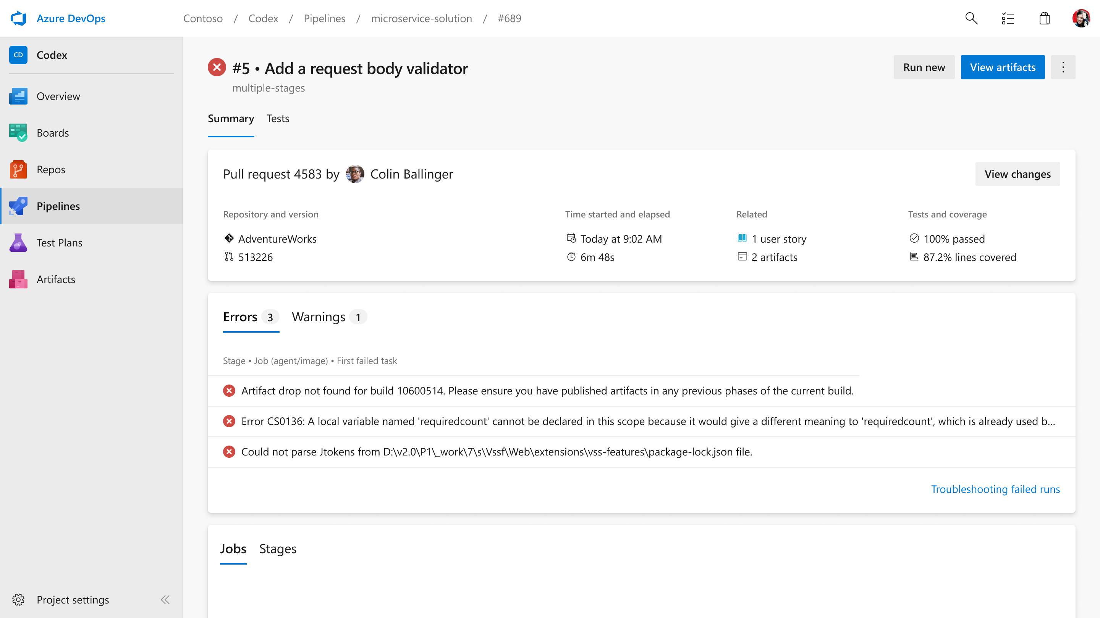
Pipeline logs
Error presentation

Slide 44
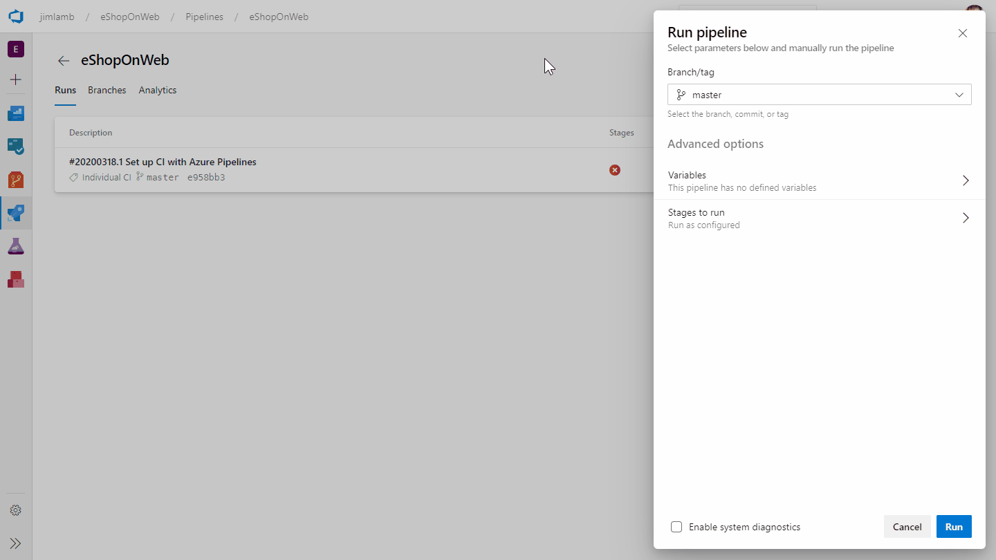
Recorded walkthrough

Slide 45
Challenges
Keyboard navigation
Using another team’s component (Visual Studio Code)
Accessible color schemes

Slide 46
Other projects
Pipeline run log view improvements
Onboarding to Azure’s Kubernetes Service
Notifications for Teams and Slack
Intelligent pipeline YAML editor
Accessibility Insights integration with GitHub Actions
Pipeline run retention and settings

Slide 47
Design system contributions
Navigating multiple pages within a panel/fly-out
Zero data
Master-detail
Accordion, collapsible card
Segmented control (choice chips)
Multi-pane workspaces
https://developer.microsoft.com/en-us/azure-devops/

Slide 48
THANKS!
Any questions?
You can find me at:
https://www.linkedin.com/in/jlamb
hey@jimlamb.design
919-475-7244

